Slide 1
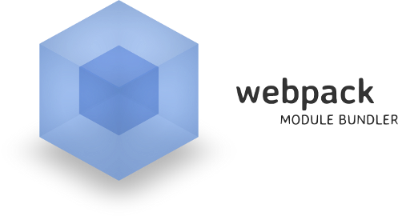
Webpack
Build Process, Basic Builds, Configuration
SoftUni Team
Technical Trainers
Software University
http://softuni.bg

Slide 2
Table of Contents
Introduction
What is Webpack?
Installation
Build Process
Basic Builds
Creating a Bundle
Configuration

Slide 3
Have a Question?
sli.do #JS-CORE

Slide 4

Webpack
A Wicked Smart Module Bundler

Slide 5



What is Webpack?
One of the newest tools, combining build steps and bundling
Bundles JavaScript files for usage in a browser
Supports dependency management
Can load any 3rd party library as a module
Comes with it's own development server
JS
JS
JS
JS
Bundle
CSS
CSS
CSS
CSS

Slide 6
Installation and CLI
Install Webpack via npm locally
--save-dev is used for production mode (development dependency)
Install the Webpack-cli
Used to run Webpack on the command line
Install the add-on development server
npm install webpack --save-dev
npm install webpack-cli --save-dev
npm install webpack-dev-server -g

Slide 7

Webpack Build Process
JS
JS
JS modules with dependencies
JS
JS
JS
Stylesheets
Bundle
Deployment
CSS
CSS
CSS
Images and other assets

Slide 8
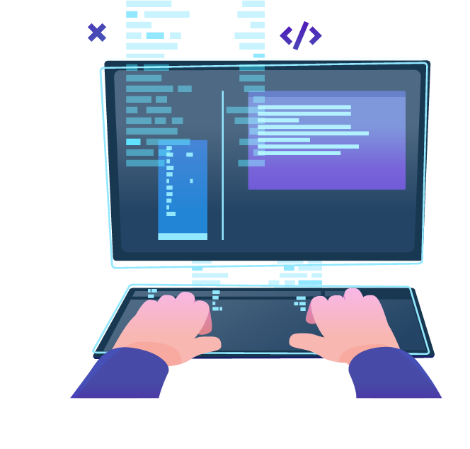
Basic Builds
Creating a Bundle

Slide 9
Getting Started
Run the following command to initialize a project:
Create a folder src
Inside it create files index.html and index.js
The project directory structure should look like this:
npm init --yes
webpack-demo
|- package.json
+ |- /src
+ |- index.html
+ |- index.js

Slide 10
Getting Started
Adjust package.json to prevent an accidental publish of code:
Mark the package as private
Remove the main entry
{
"private": true, // add
"main": "index.js", // remove
}

Slide 11
Creating a Bundle
To build a project for locally installed webpack, run either of the following commands:
If the main JS file is not named index.js, execute the following command to specify the name:
npx webpack
.\node_modules\.bin\webpack
\.node_modules\.bin\webpack .\src\myIndex.js

Slide 12

Configuration
Creating webpack.config.js file

Slide 13
Creating Configuration
Create webpack.config.js in your project folder
Entry - the name of the main source code file
Filename - the name of the file with minified code
const path = require('path');
module.exports = {
entry: './src/index.js',
output: {
filename: 'main.js',
path: path.resolve(__dirname, 'dist')
}
}

Slide 14
Creating Configuration
To run the build again using the new configuration file, use the following command:
To use the 'npm run build' command, adjust the package.json file by adding a 'npm script':
npx webpack --config webpack.config.js
"scripts" : {
"start": "webpack" "build": "webpack"
}

Slide 15
Loading CSS
To import a CSS file within a JavaScript module, install the style-loader and css-loader
Add the following code to webpack.config.js
npm install --save-dev style-loader css-loader
module: {
rules: [ {
test: /\.css$/,
use: [
'style-loader',
'css-loader']
} ] }

Slide 16
Adding a Config File
Create a webpack.config.js to automate your build
Configuration is in JSON format
When running webpack from the terminal, it uses this config
module.exports = {
entry: "./app.js",
output: {
filename: "bundle.js"
}
};
Starting module
Final output file

Slide 17
Enable Watch Mode
Webpack can watch for file changes and rebuild the bundle
Add an argument or change your config file to enable hot reloading
webpack --watch
module.exports = {
entry: … , output: … ,
watch: true
};

Slide 18
Web Server with Watch Mode
Run the development server from the terminal
Change your config file to enable hot reloading
webpack-dev-server -g
module.exports = {
entry: … , output: … ,
devServer: {
publicPath: "/dist/",
watchContentBase: true,
}
};

Slide 19
Building Multiple Files
Requiring files
Adding an additional entry file to our webpack.config.js file
require("./file")
module.exports = {
entry: ["./global.js", "./app.js"],
output: {
filename: "bundle.js"
}
};

Slide 20
Processing Files with Loaders and Preloaders
Loaders apply transformations to files
Can be downloaded with npm and configured in the main config
Preloaders are the same, they just run before any loaders
module.exports = {
entry: "./entry.js",
output: {filename: "bundle.js"},
module: {
loaders: [ … ]
}
};
Loader format
{
test: /\.js$/,
exclude: /node_modules/,
loader: "babel-loader"
}

Slide 21
Creating a Start Script
Webpack uses npm scripts for further automation
Add to your package.json file
Instead of running webpack-dev-server, we can run the following instead
scripts: {
"start": "webpack-dev-server"
};
npm start

Slide 22
Production and Development Builds (1)
To minify the bundle for deploy, run webpack with –p argument
Install strip-loader
Strips arbitrary functions out of your production code
Create webpack-production.config.js
You can specify a different config file for production
webpack -p
npm install strip-loader --save-dev
webpack --config webpack-production.config.js -p

Slide 23
Production and Development Builds (2)
In the webpack-production.config.js write the following code:
Require the strip-loader npm module
Require the original webpack configuration file
var WebpackStripLoader = require('strip-loader');
var devConfig = require('./webpack.config.js');

Slide 24
Production and Development Builds (3)
Create a new object, and pass in the test, exclude and loader keys
var stripLoader = { test: [/\.js$/, /\.es6$/],
exclude: /node_modules/,
loader: WebpackStripLoader.loader('console.log') }

Slide 25
Production and Development Builds (4)
Push the new object into our loaders array from our original config
Export our new config object
devConfig.module.loaders.push(stripLoader);
module.exports = devConfig;

Slide 26

Summary
Arrow functions ≈ short function syntax
Webpack is a module bundler
It comes with its own development server
The "distribution" code is the minimized and optimized output of the build process
To load CSS, images, font and data, certain libraries have to be installed and imported

Slide 27
Summary (2)
Arrow functions ≈ short function syntax
Webpack is a module bundler. It relies on:
Dependency graph underneath
Loaders and plugins
Its configuration describes how to transform assets of the graphs
Features like code splitting are used
It comes with it's own development server

Slide 28
https://softuni.bg/courses/js-apps

Slide 29












SoftUni Diamond Partners

Slide 30




SoftUni Organizational Partners

Slide 31




Trainings @ Software University (SoftUni)
Software University – High-Quality Education and Employment Opportunities
softuni.bg
Software University Foundation
http://softuni.foundation/
Software University @ Facebook
facebook.com/SoftwareUniversity
Software University Forums
forum.softuni.bg

Slide 32

License
This course (slides, examples, demos, videos, homework, etc.) is licensed under the "Creative Commons Attribution-NonCommercial-ShareAlike 4.0 International" license

